Slide 1
Intro to REA
Selected slides from Bill McCarthy, the father of REA
and a few slides from other people.

Slide 2
R
E
A
Economic Resource
stockflow
Economic Event
participation
Economic Agent
duality
The REA pattern

Slide 3
an accounting story
Once upon a time at the cookie store ……

Slide 4
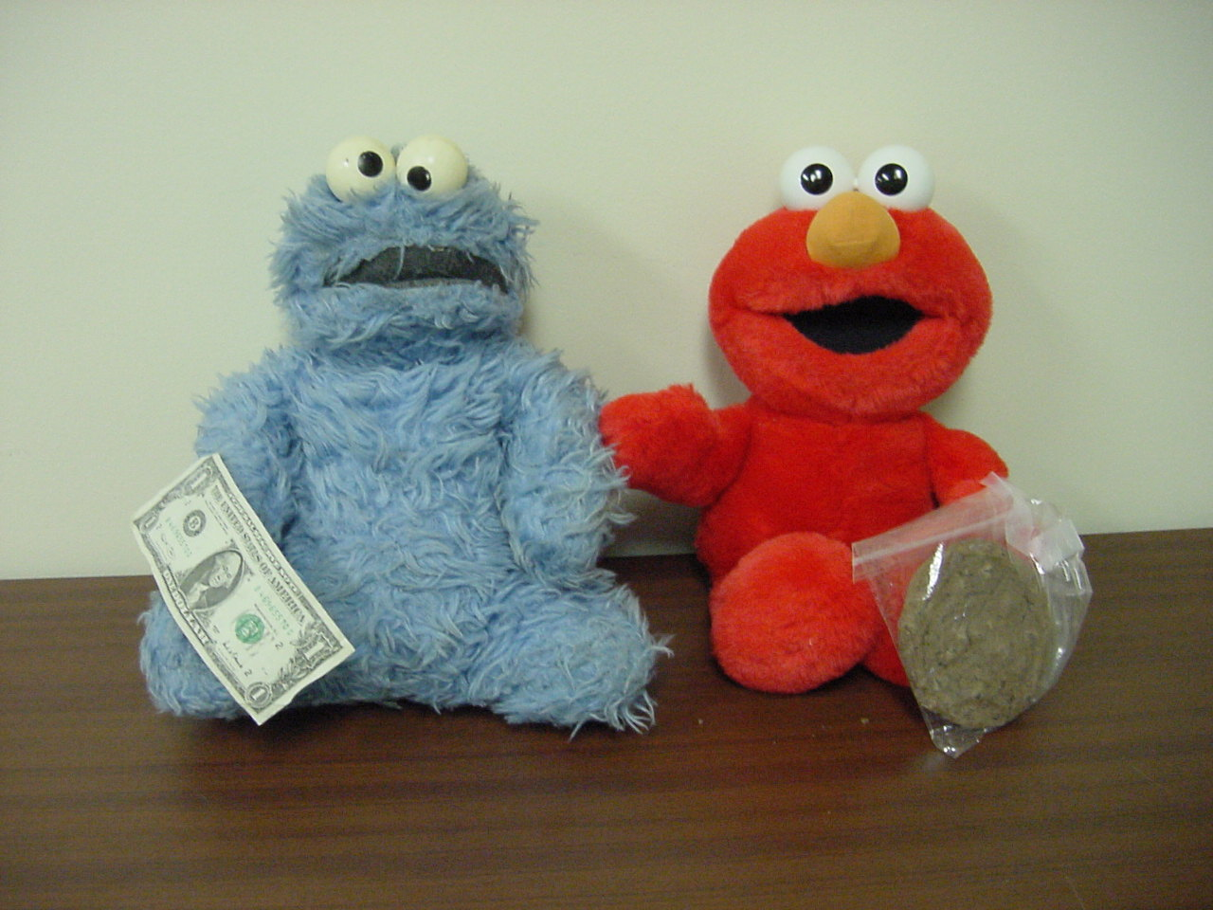
Cookie-Monster (the monster) and Elmo (the baker) meet in the (real or virtual) marketplace, thus setting the stage for an Economic Exchange

Slide 5
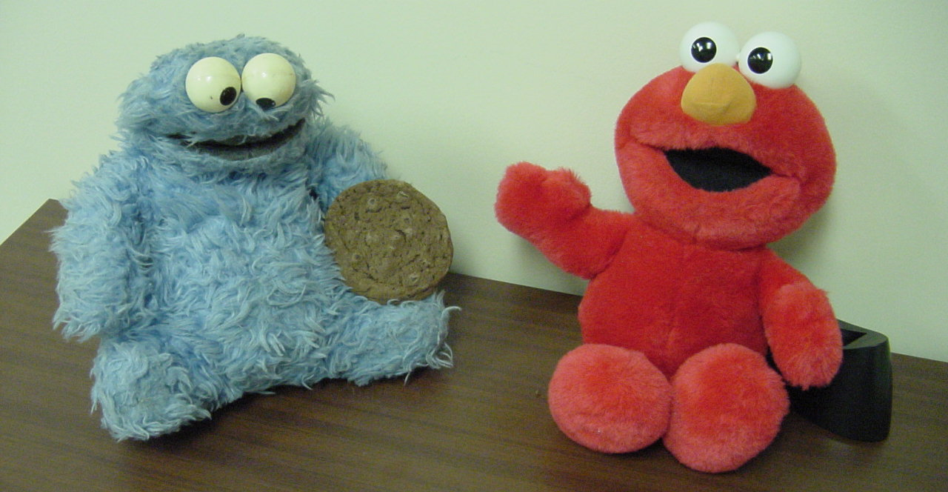
Cookie-Monster and Elmo engage in a SALE (transfer of Cookie Inventory)

Slide 6
Economic Resource
Cookies
Economic Agent
insideParticipate
entrepreneur
Economic Event
stock-flow
Sale
Economic Agent
outsideParticipate
duality
customer
Economic Agent
insideParticipate
Economic Event
stock-flow
outsideParticipate
Economic Agent
Economic Resource
A patterned category model for exchange process

Slide 7

Cookie-Monster and Elmo engage in a PAYMENT (transfer of Cash)

Slide 8
Economic Resource
Cookies
Economic Agent
insideParticipate
entrepreneur
Economic Event
stock-flow
Sale
Economic Agent
outsideParticipate
duality
customer
Economic Agent
insideParticipate
Economic Event
entrepreneur
stock-flow
Cash-Receipt
outsideParticipate
Economic Agent
Economic Resource
customer
Cash
A patterned category model for exchange process

Slide 9
Economic Resource
Economic Agent
WHAT?
WHO?
outsideParticipate
Economic Event
Economic Agent
stockFlow
WHEN?
insideParticipate
WHO?
duality
WHY?
Economic Event
The What, When, Who, and Why Translation of a Business Process

Slide 10
Economic Resource
Economic Agent
direct object
prepositional phrase
outsideParticipate
Economic Event
stockFlow
Economic Agent
verb
insideParticipate
subject
Normal Sentence Translation of the REA Metamodel
Alice
purchased
eggs
some
from
Jones Company
and
Carol
disbursed
$20.60
to
Jones Company
Transactions Diagrammed as an REA-Patterned Compound Sentence

Slide 11
Legacy Accounting Systems (A = L + OE)
Enterprise Value Chain (legacy ERP)
Value Network (Independent view)
Enterprise Value Chain (non-legacy ERP)
firm–b
source document
firm–a
Financial
Other
Reporting View
Views of
Enterprise
transactions & master files
Event-chains
distributed business transaction repository
.
Value Network (Trading Partner view)
Financial Statements
Value Network (legacy hybrid)
firm–b
is-a
firm–b
firm–c
GL
firm–a
Enterprise Value Chain (legacy ERP)
Enterprise Value Chain (legacy ERP)
distributed ledger
Figure 1 – Enterprise System Evolution (Source: adapted from David et al. 2003)
firm–c
On-premise
Cloud-based
GL
firm–a

Slide 12
The Policy Layer
typify
policy
Economic Resource Type
policy
Economic Event Type
policy
Economic Agent Type
typify
typify
specify
specify
specify
Economic Contract
trigger
bundle
Economic Commitment
The Scheduling Layer
reciprocal
fromPromise
toPromise
reserve
fulfill
reserve
fromParticipate
Economic Resource
stockFlow
Economic Event
Economic Agent
responsible
toParticipate
duality
partyNegotiate
counterpartyNegotiate
The Accountability Layer
Figure 3 -- The Independent REA (Resource-Event-Agent) Metamodel (Source: McCarthy et al. 2018)

Slide 13

REAContracts
Adding sematics to business contracts
Jesper Kiehn (Simon Peyton-Jones)

Slide 14
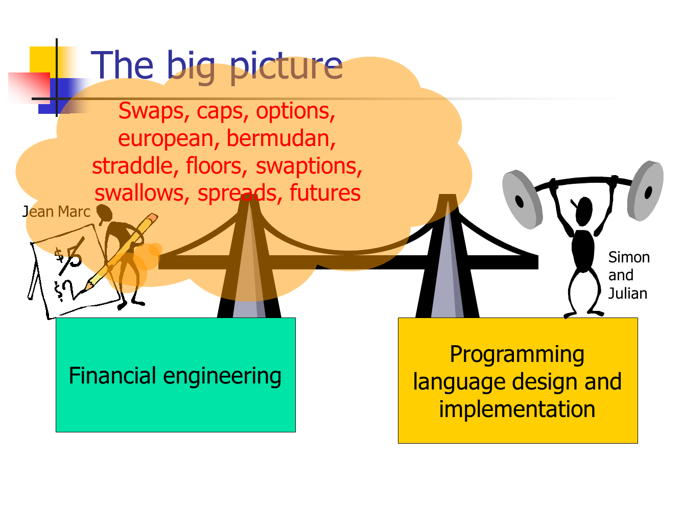
2

Slide 15
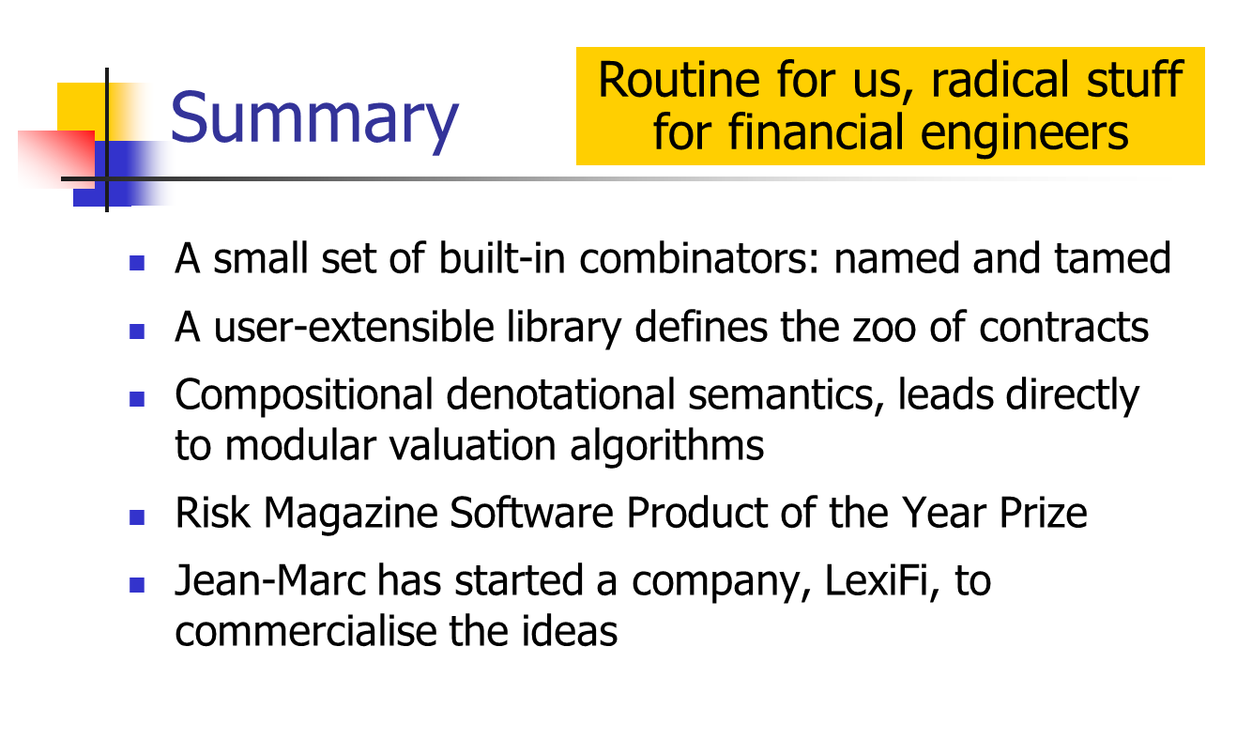
16

Slide 16
Figure 4 – Accountability Layer for an Open Value Network (Source: McCarthy et al. 2018)
labor
materials
creating value
equipment
Contribution
(project step)
duality
prototypes
Deliverable
Project
stockFlow
ideas
duality
Contribution (project step)
designs
other
distributing value
stockFlow
transfer or use of project value to party outside the value network
payment or value enhancement distribution to individual value creators based on value accounting system
duality
Value accounting system uses REA model of material or assets purchased + labor + roles played + tasks accomplished + prototype or designs submitted + creative ideas + other factors deemed relevant by network participants

